Slide 1


Alexa Skill Kit Bootcamp

Slide 2



Meet the instructors
Igor Escodro
Wagner Lima
Rodrigo Mendonça

Slide 3


Alexa, who are you?
Personal Smart Assistant
Multi-platform (1st and 3rd party)
100M+ devices sold

Slide 4
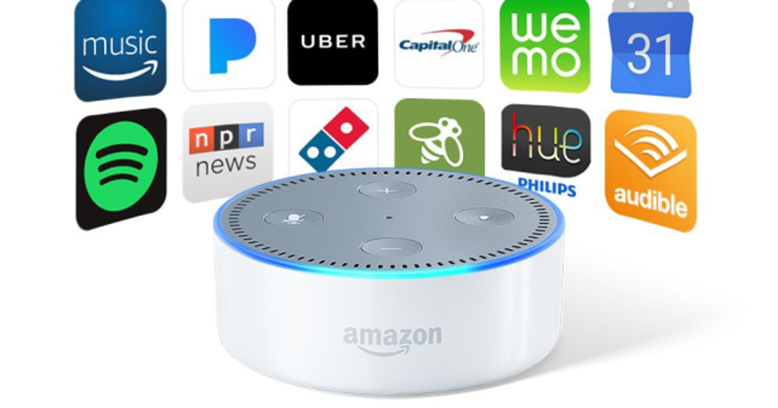
Alexa Skill
Voice (and visual) apps
70K+ skills in all markets
“Alexa, ask Spotify to play Maroon 5”

Slide 5





Interaction architecture
User
Echo
Skill
Lambda
Server

Slide 6
Interaction architecture
User
Echo
Skill
Lambda
Server

Slide 7
What’s Alexa Skill Kit
Builds the voice model
Developed in Alexa Developer Console
Visual tool (JSON under the table)

Slide 8
What’s Lambda
Event-driven, serverless computing platform
Processes the Intent and responds to the skill
Developed in Amazon Web Services
Node.js, Python and Java support

Slide 9
Creating a skill
Setup:
Alexa Skill Kit
AWS Lambda
Linking

Slide 10
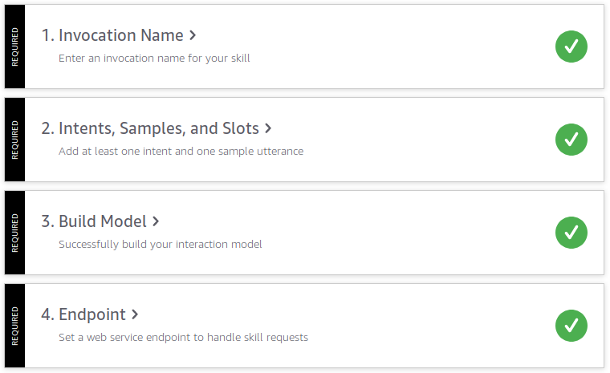
Skill Checklist
Invocation Name
Intents, Samples and Slots
Build Model
Endpoint

Slide 11
Invocation Name
Skill trigger
Should have two or more words
Must not be reserved or conflicting
Suggestions:
Alexa, open bootcamp
Alexa, ask my first skill to [...]

Slide 12
2. Intents and Samples
Intents identifies the user intention (NLU)
Samples are “all” the possible sentences
Richer samples provides richer interactions

Slide 13
2. Intents and Samples
WeatherIntent
How’s the weather today? Show me the weather Is the weather fine today? Tell me the weather I want to know the weather [...]
TaxiIntent
I want a ride I need a cab Order me a car Order me a cab right now Send me a car [...]

Slide 14
2. Slots
Defines parameters to be handled from the speech
Parameters to be processed in the Lambda side
It is possible to define synonyms

Slide 15
2. Slots
Candy
chocolate donut cookie cake pie [...]
TaxiType
TaxiPool TaxiSelect TaxiX Taxi Black [...]

Slide 16
2. Slots (in Intents)
WeatherIntent
How’s the weather {Day}? Show me the weather in {Location} Is the weather {Condition}? Tell me the weather at {Time} Weather in {Location} at {Time} [...]
TaxiIntent
I want a {TaxiType} I need a cab in {Number} hours Order me a car at {time} Order me a {TaxiType} right now Send me a car in {location} [...]

Slide 17
2. Slots (Alexa’s built-in library)
Library with 100+ existing slots
Makes the development faster and more reliable
Slots for date, time, actor, movies, colors, animals, games, books etc.

Slide 18
3. Build Model
Just press Build Model
Changes only reflects after this step

Slide 19
4. Endpoint
Sends the processed user speech to the Endpoint
Two-way communication
AWS Lambda ARN highly recommended

Slide 20
Creating a skill
Setup:
Alexa Skill Kit
AWS Lambda
Linking

Slide 21
Creating a Function
Go to https://console.aws.amazon.com/lambda/
Create a function
Execution role > Create a new role with basic Lambda permissions
From scratch
Create Function!

Slide 22
Hello from Lambda!
exports.handler = async (event) => { // TODO implement const response = { statusCode: 200, body: JSON.stringify('Hello from Lambda!'), }; return response; };

Slide 23
Creating a skill
Setup:
Alexa Skill Kit
AWS Lambda
Linking

Slide 24
Copying the Skill ID
On Alexa Developer Console:
Go to Endpoint
Select AWS Lambda ARN
Copy Your Skill ID
Example: amzn1.ask.skill.09768082-0397-41c0-9579-1504f70d1993

Slide 25
Linking with Lambda
On Lambda Console:
Go to Designer
Add triggers > Alexa Skills Kit
Configure triggers > Enable
Paste your Skill ID
Always remember to save!

Slide 26
Linking with ASK
On Lambda Console:
Copy the ARN ID (from Lambda Console)
On Alexa Developer Console:
Paste the ARN ID in Default Region
Always remember to build!

Slide 27
Let’s code!
Go to: github.com/igorescodro/alexa-bootcamp

Slide 28
Hello World!
On Alexa Developer Console:
Create Skill
Add a invocation name
Create HelloIntent
Build

Slide 29
Hello World!
On Lambda Console:
Create a new Lambda from scratch
Upload the base structure
Write your first method!
Don’t forget to link it up!

Slide 30
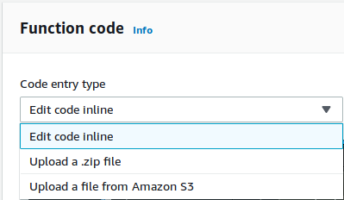
Importing default structure
Code entry type > Upload a .zip file
Upload
alexa_bootcamp_base.zip
Save!
Code entry type > Edit code inline

Slide 31
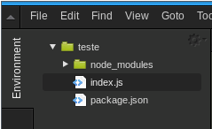
Hello from ASK SDK!
const Alexa = require('ask-sdk-core'); const skillBuilder = Alexa.SkillBuilders.custom(); exports.handler = async (event) => { // TODO implement const response = { statusCode: 200, body: JSON.stringify('Hello from Lambda!') }; return response; };

Slide 32
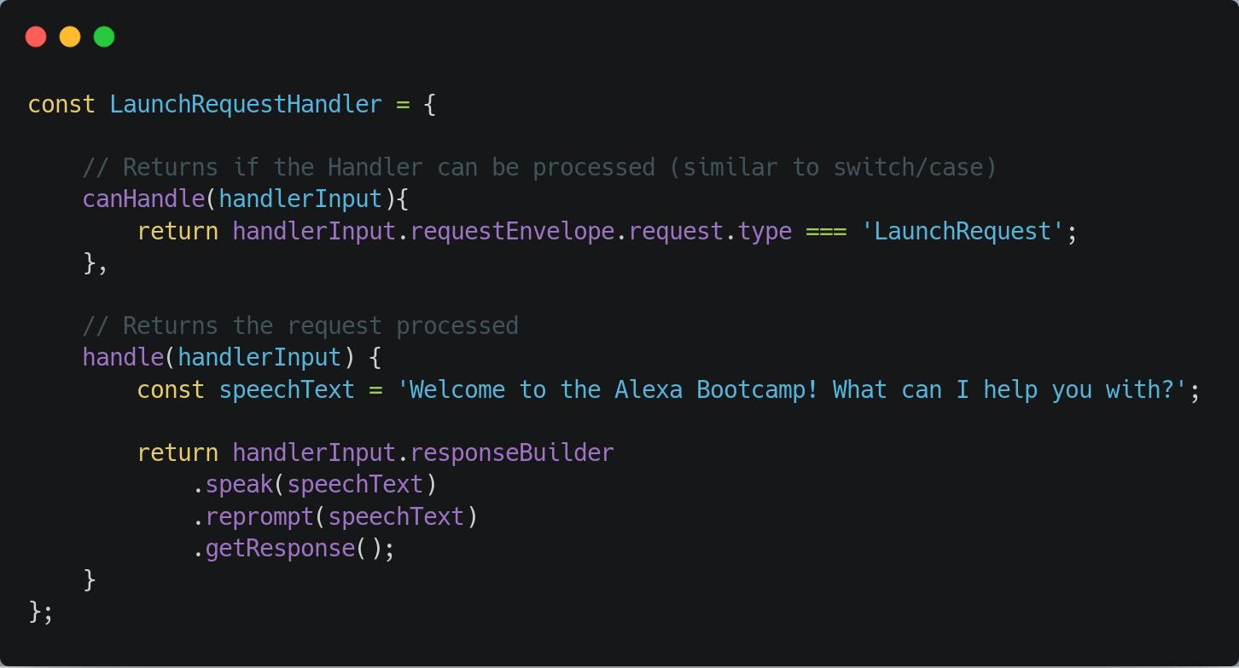
Creating Intent Handlers

Slide 33
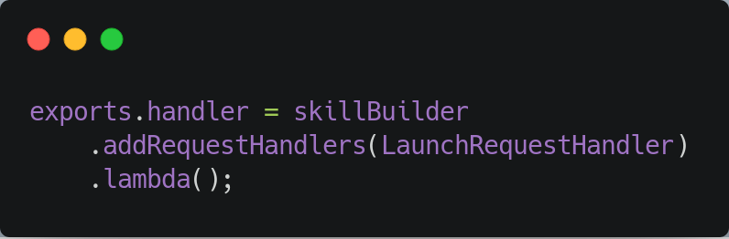
Registering Intent Handlers

Slide 34
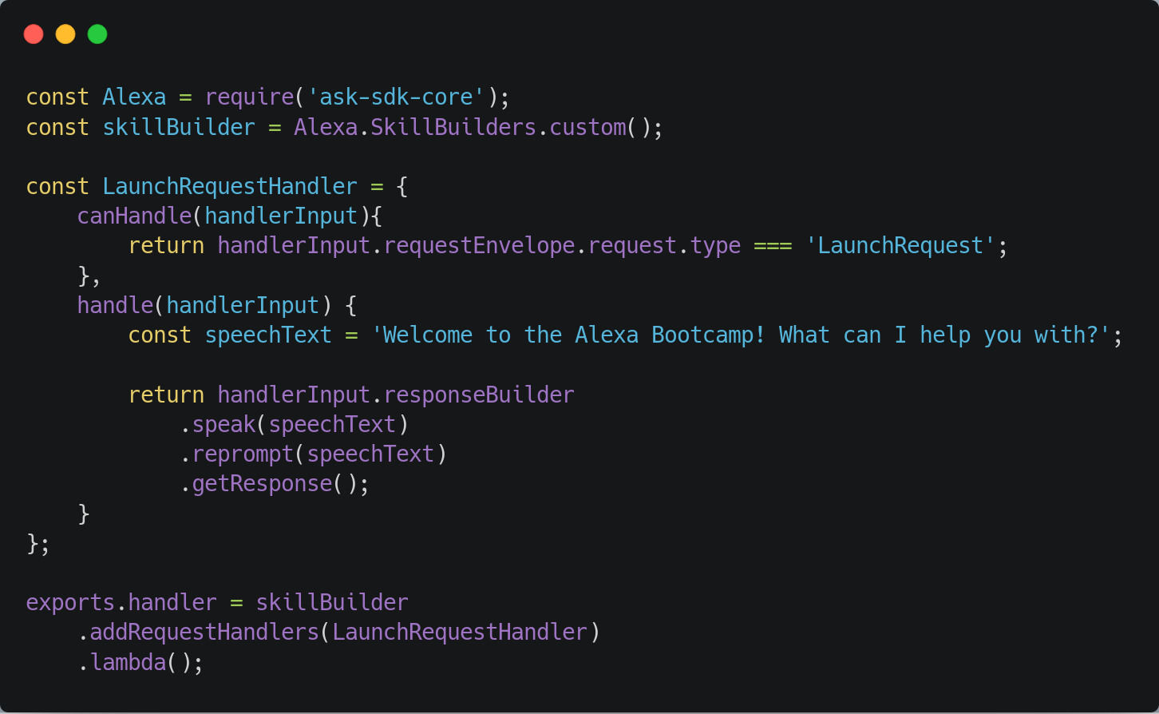

Slide 35
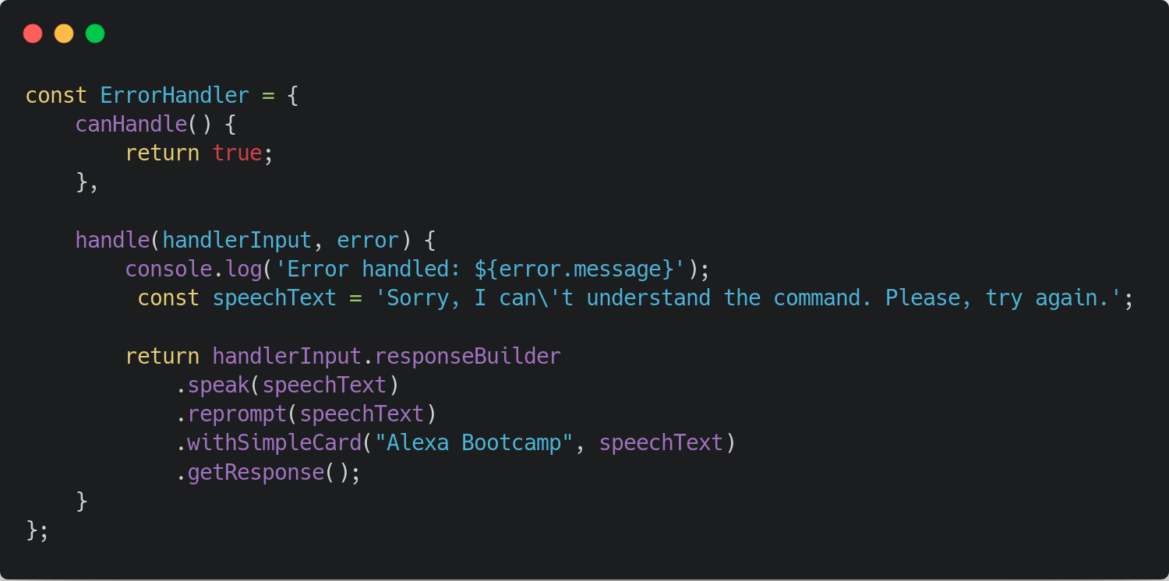
Creating an Error Handler

Slide 36
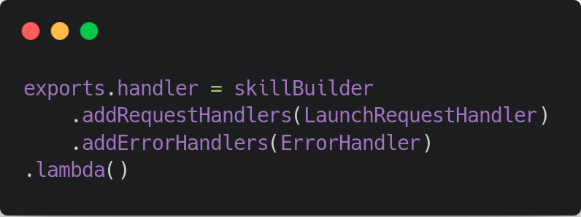
Registering Error Handler

Slide 37
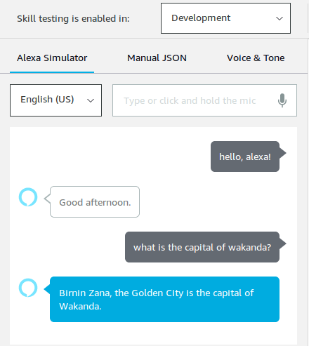
But how do I test it?
No Echo, no problem
On Alexa Developer Console:
Go to Test
Change from Off to Development
Send commands!
Please, connect your headphones

Slide 38
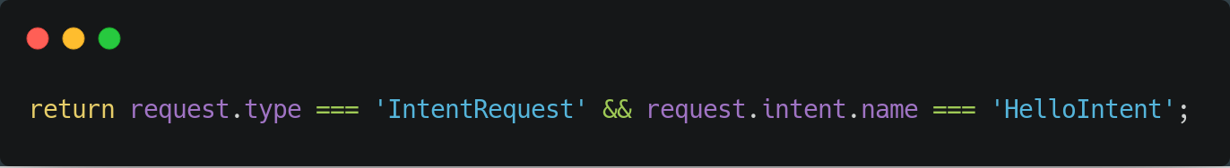
Exercise 1
Create the HelloIntentHandler

Slide 39
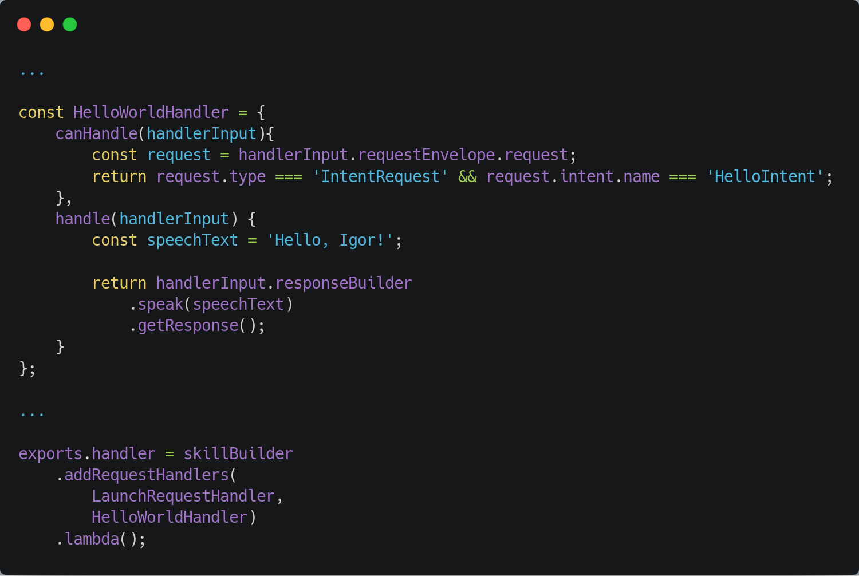

Slide 43
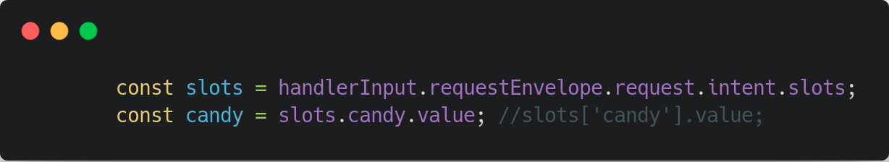
Exercise 2
Create the BuyCandyIntent with Custom Slots

Slide 44
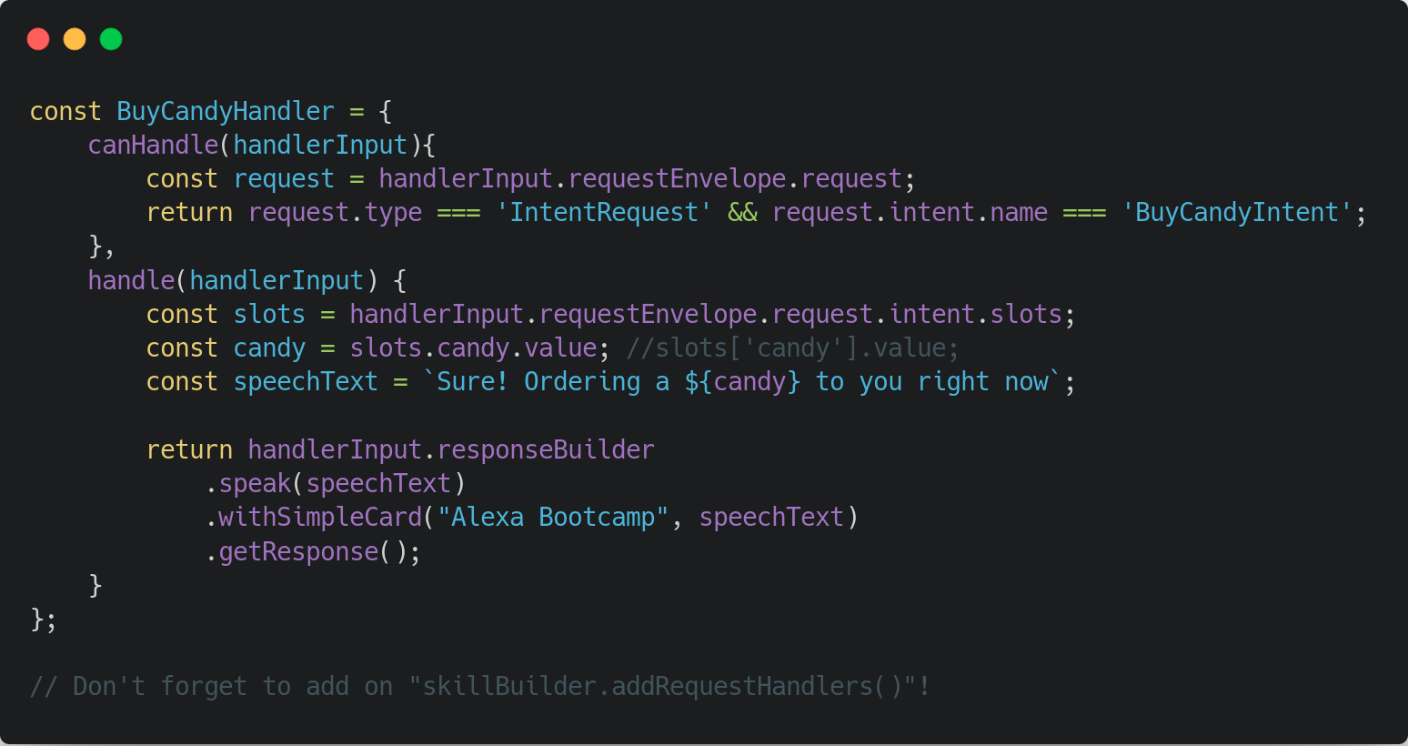

Slide 48
?

Slide 49
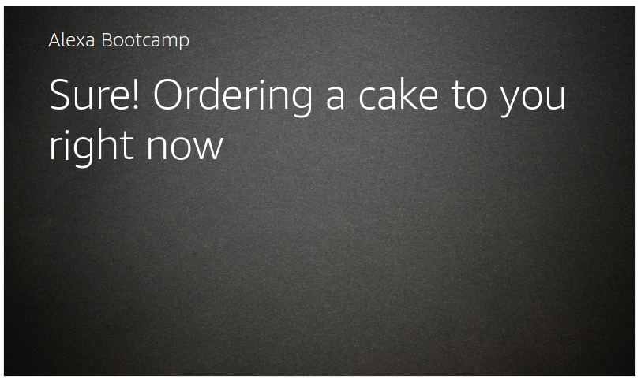

Slide 50
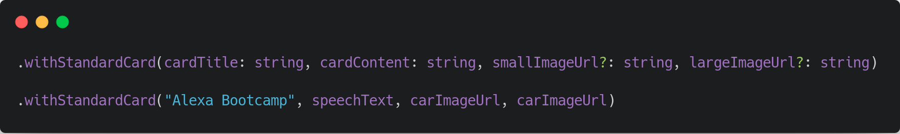
Exercise 3
Create the CarColor with Existing Slots and Image Cards

Slide 51
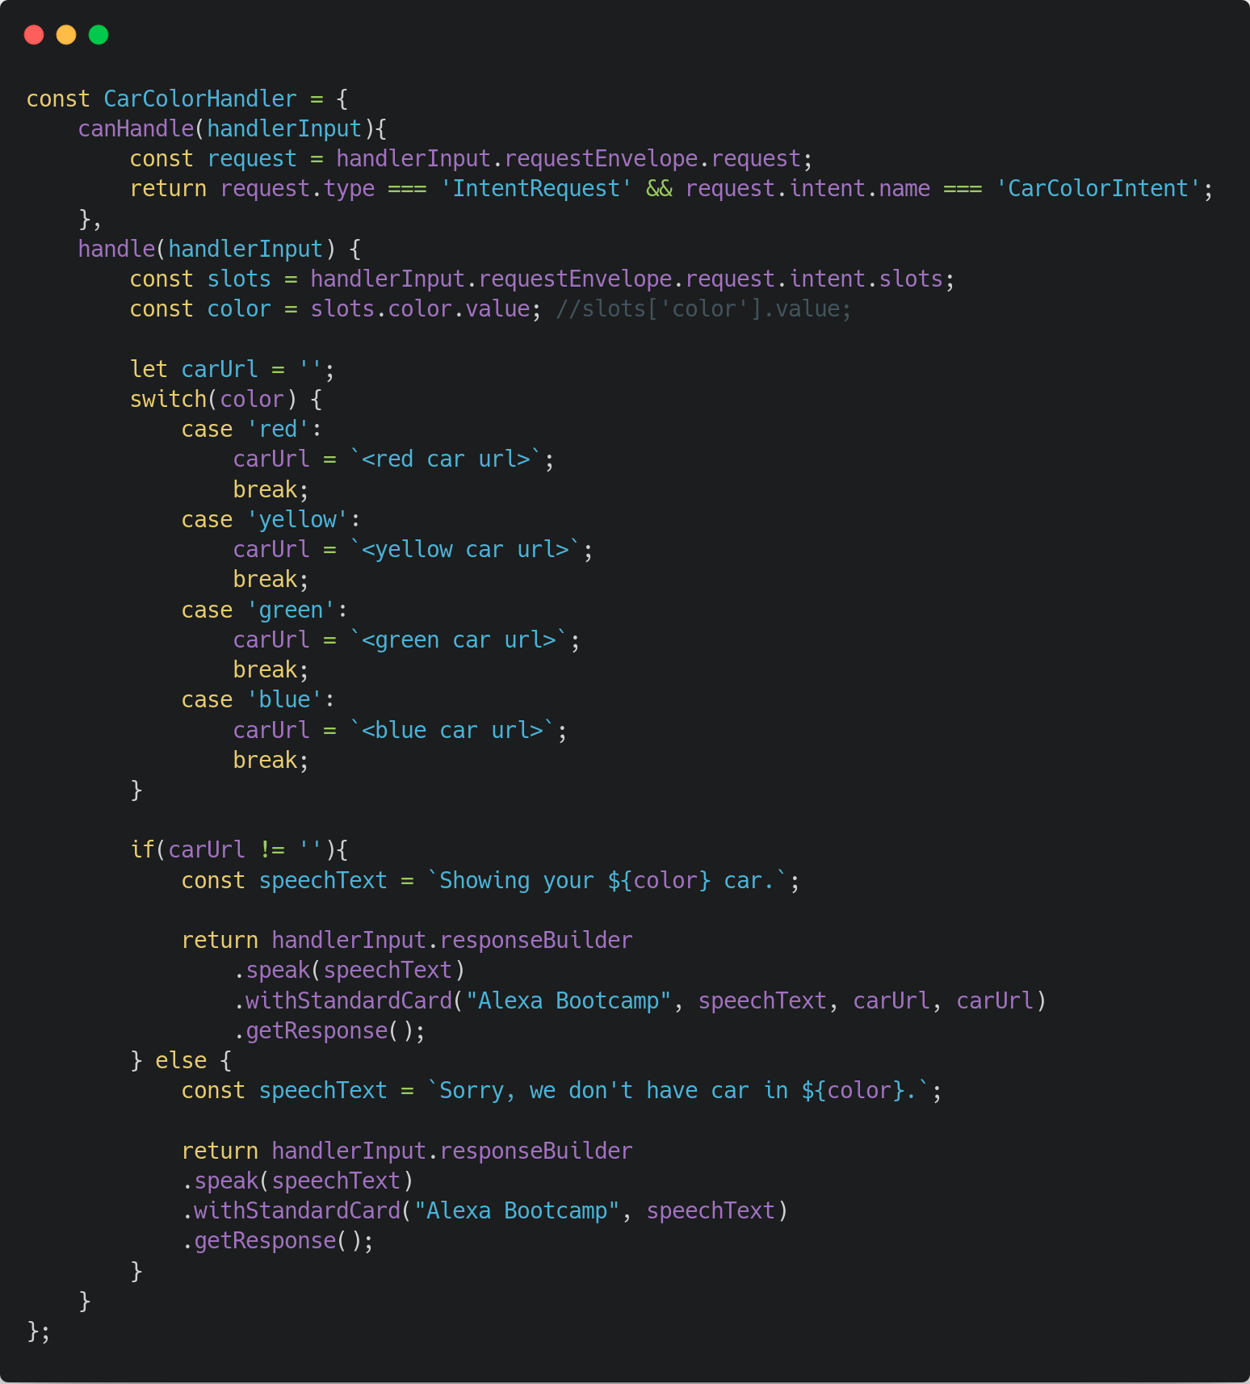

Slide 53
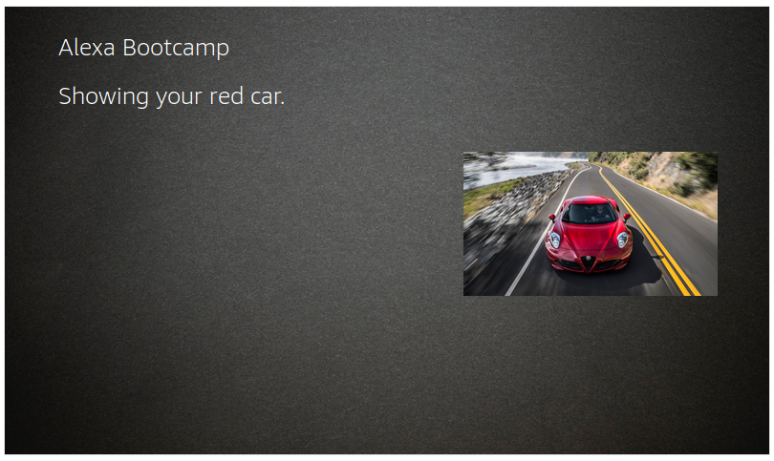

Slide 54
Multiturn interactions

Slide 55
Multiturn interactions
Information are provided step by step
Better User Experience
More complex and human interactions

Slide 56
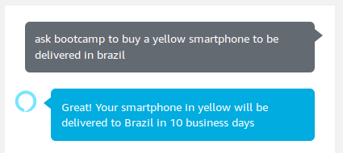

Slide 58
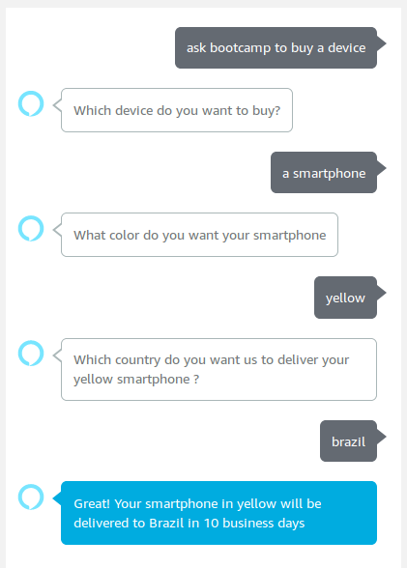

Slide 59
Multiturn skill
Steps:
Adding utterance with slots
Creating dialogs to the slots
Handling the response on Lambda

Slide 60
Adding slots
device AMAZON.DeviceType
country AMAZON.Country
color Amazon.Color

Slide 61
Utterance with slots
I want to buy a product
Buy a {color} {device} to be delivered in {country}
I want to buy a device
I need a {device} in {country}
I want to buy a {device}

Slide 62
Multiturn skill
Steps:
Adding utterance with slots
Creating dialogs to the slots
Handling the response on Lambda

Slide 63
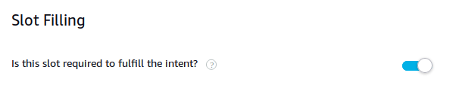
Editing the dialogs
Intent > Actions > Edit Dialog
Is this slot required to fulfill the intent?

Slide 64
Alexa speech prompts
Prompt the user for the value of the slot
Which device?
We have a lot of devices. Which one do you need?
Which device do you want to buy?

Slide 65
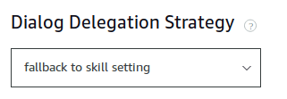
Delegation strategy
Intent > Dialog Delegation Strategy
fallback to skill setting

Slide 66
Multiturn skill
Steps:
Adding utterance with slots
Creating dialogs to the slots
Handling the response on Lambda

Slide 67
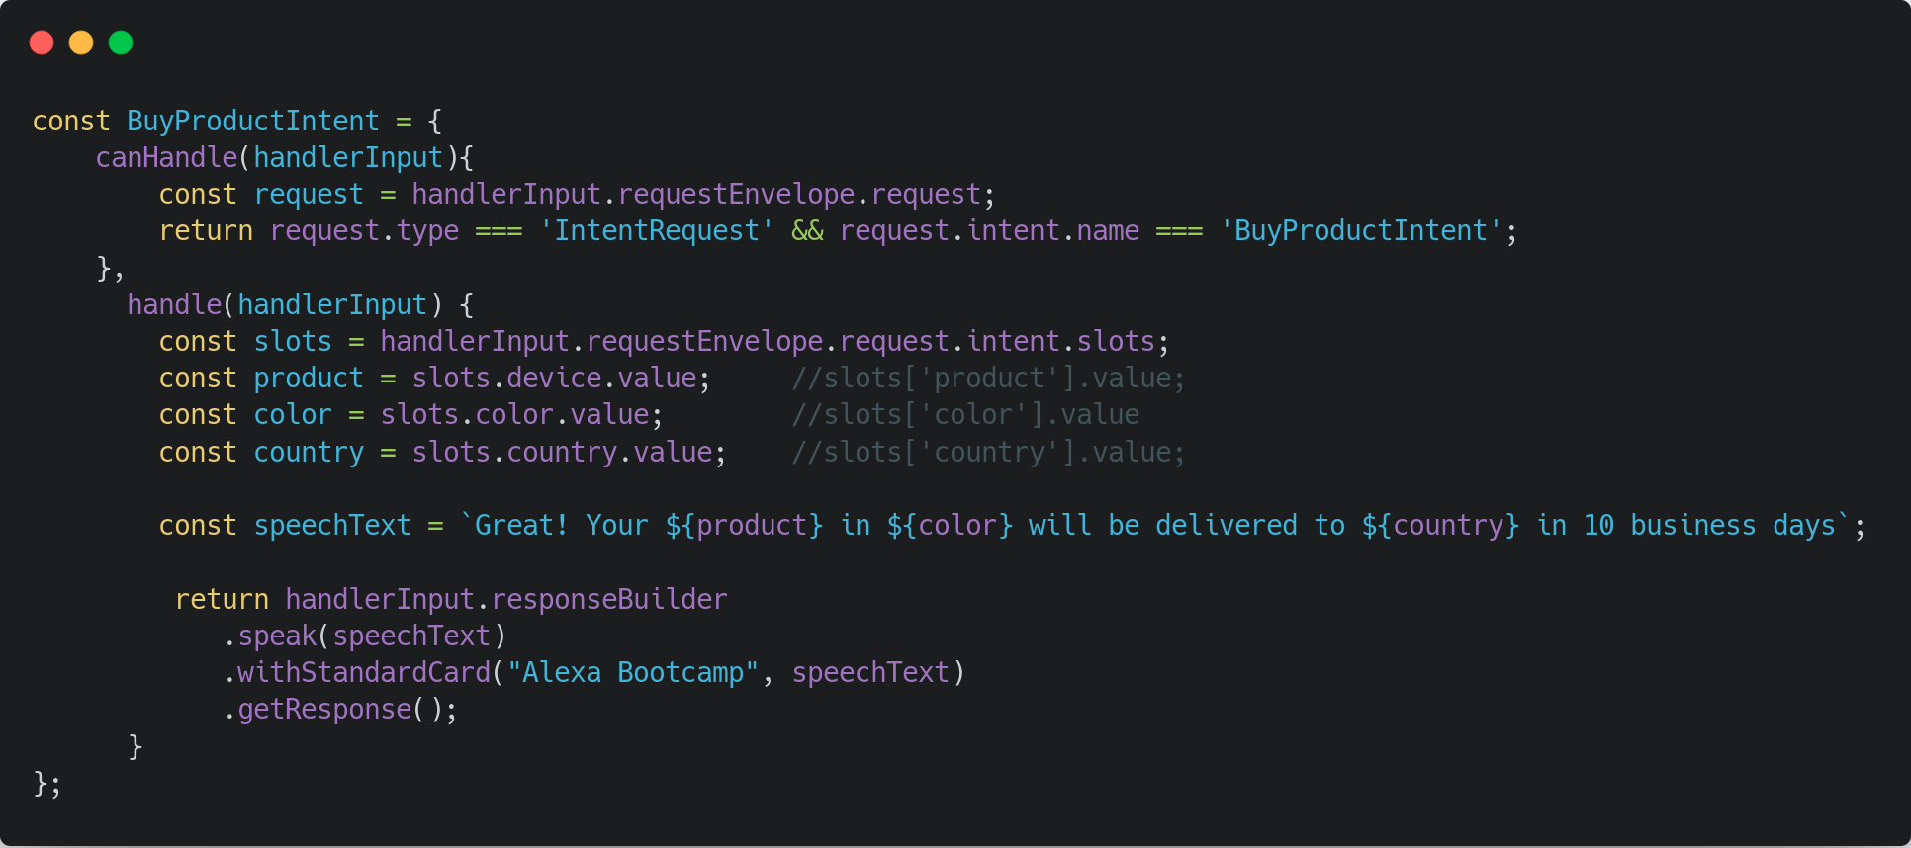

Slide 68
What’s next?

Slide 69
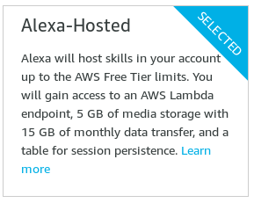
Alexa-Hosted Skill
Easy setup
AWS Free Tier
Ready, set, GO!

Slide 70

Smart Home Skill API
Skills for Smart Home
No custom intents, slots and utterances
Server based
Keep an eye on it...

Slide 71
Useful Links
ASK Documentation for Node.js
Developing Your First Skill
Alexa SDK on GitHub
Alexa Skill Building Cookbook
Speech Synthesis Markup Language
Making HTTP/API calls
Skills on CLI
Alexa-hosted Skill

